Slide 1

Permission Impossible
Dead Reckoning Pain
Notes:
Thanks for coming to my talk “Permission Impossible Dead Reckoning Pain” today, where I will be telling you a story about a real life project that I had to do that became the inspiration for this talk

Slide 2



Notes:
So before I begin …. <Acknowledgement of Country”>

Slide 3

Shameless Self-Plug
Francis Chung
Co-Organiser of Alt.Net and DDD-AU Meetups
30 years in the industry
Fun Fact
My first computer was an Apple II
Am I a real Apple Fanboi?
Notes:
… and you might be wondering “Am I an Apple Fanboi when I am clearly using a fake apple laptop to do this presentation” - I’ll let you make up your minds on that

Slide 4
Once upon a time ….
Notes:
If you’ve been in the industry for 30 years, all your stories starts with “Once upon a Time …” so …. “Once upon a time … “

Slide 5

Notes:
I worked as a Principal Engineer at FBs in far away city called Amsterdamage. FreshBooks is an Accounting Platform, main market US/Canada, 1 million plus users worldwide

Slide 6
An Impossible Mission was given
Notes:
So sticking to the theme,, An Impossible Mission was given to myself …

Slide 7
Introduce a new User Class The FIRM Accountant
Notes:
You might be wondering how is this an Impossible Mission? What in the world is a FIRM Accountant?

Slide 8

This handsome Accountant
with the firm grip?
Notes:
… and the firm stare ….

Slide 9

More like this guy with the Firm Accountant looks …
The world can be accrual sometimes
Notes:
Basically like an external Accountant or Auditor that shares some but not all access rights as your regular accountant. Apologies to any real accountants in the room. I’ll take an Accrual beating in the corner after the Q&A session at the very end. So feel free to ask a million questions during the Q&A at the end.

Slide 10
The FIRM Accountant -
External Auditor, External Accountant
Notes:
Introducing a new user class? How hard can this be? So I did some analysis of the task at hand

Slide 11
Analysis
Notes:
Introducing a new user class? How hard can this be? So I did some analysis of the task at hand

Slide 12
Analysis
933 potential code changes spanning across 6 systems
Notes:
Hmm that;s a lot of changes …

Slide 13
Analysis
933 potential code changes spanning across 6 systems
Given 1 Intern Developer for the project

Slide 14
Analysis
933 potential code changes spanning across 6 systems
Given 1 Intern Developer for the project
I wasn’t allowed to code (Too expensive they said)
Notes:
I think it was a kind way of saying, your bugs are going to be too expensive to fix

Slide 15
Analysis
933 potential code changes spanning across 6 systems
Given 1 Intern Developer for the project
I wasn’t allowed to code (Too expensive they said)
I had 2 months to deliver

Slide 16
Risks
Code Changes wasn’t the biggest challenge

Slide 17
Risks
Code Changes wasn’t the biggest challenge
First new user class in 5+ years
Notes:
… and we are talking about E2E Testing throughly

Slide 18
Risks
Code Changes wasn’t the biggest challenge
First new user class in 5+ years
Testing this however => E2E Testing of entire system
Notes:
… and we are talking about E2E Testing throughly

Slide 19
Risks
Code Changes wasn’t the biggest challenge
First new user class in 5+ years
Testing this however => E2E Testing of entire system
Unfamiliar with most of the FBs eco system
Notes:
… and we are talking about E2E Testing throughly

Slide 20
Your project / sanity will self destruct in ….
Notes:
<Hair Pulling Gesture> - A good representation of my brain at the time

Slide 21
Permission Impossible
Dead Reckoning Pain
Notes:
… and hence … that became the inspiration for the title of my talk today.

Slide 22

Roughly Speaking …
Notes:
To fast forward 2.5 months later … like most IT Projects this one was late as well ….

Slide 23

2 Months of Zoom Meetings
Notes:
2 Months of Begging on Zoom can do wonders to your project. So I was allowed to touch some code but more importantly, I was able to convince some teams to take ownership for the FIRM Accountant changes, otherwise I’ll have to do the changes myself

Slide 24
Project Delivered!
Notes:
I actually delivered the project, and I didn’t break production as the Las Vegas bookies predicted and lost. Don’t bet against Francis!

Slide 25

On Reflection …
Notes:
So when I got a chance to lie down and reflect upon what I did, what I really should have done was …

Slide 26
What I should have done
Notes:
… is to jump out of the building and ran for my life and my sanity. The stress of delivering this project was pretty intense
FBs had new features on their roadmap that would require new User Classes and this exercise would be surely repeated.

Slide 27
Introduce a new User Class The SOFT Accountant
Notes:
“Hey Francis, we need a new SOFT accountant class”. And guess who’s going to be doing this again? Me & My Poor Intern!

Slide 28
There has to be a better way !
Notes:
The fear and the PTSD got me proactive and what I discovered will form the basis of the next part of my tallk

Slide 29
THE END - Part 1

Slide 30
Part 2 - Deeper Dive

Slide 31

Agenda
Permissions
Intro - AuthN vs AuthZ
Different Access Control Models
Code Examples
Q&A
Accrual Beating
Notes:
So let me quickly go through the Agenda for the rest of the talk

Slide 32
Authentication (AuthN)
vs
Authorization (AuthZ)
Notes:
When you’re talking about Application Security, permissions, identity etc, what you’re really talking about is Authentication and Authorization, which both go hand in hand. But it’s common for people to confuse the 2. So let’s first talk about what these 2 things really are.

Slide 33
Authentication (AuthN) -
Are you who you say you are?

Slide 34
Authentication (AuthN)
Notes:
So imagine having Ethan Hunt as a user. ,He’d be a nightmare to Authenticate, eh?

Slide 35
Authorization (AuthZ) - As user X =>
What are you allowed to do? What AREN’T you allowed to do?
Notes:
DONT JOKE ABOUT ELON

Slide 36
Authentication (AuthN)
vs
Authorization (AuthZ)

Slide 37
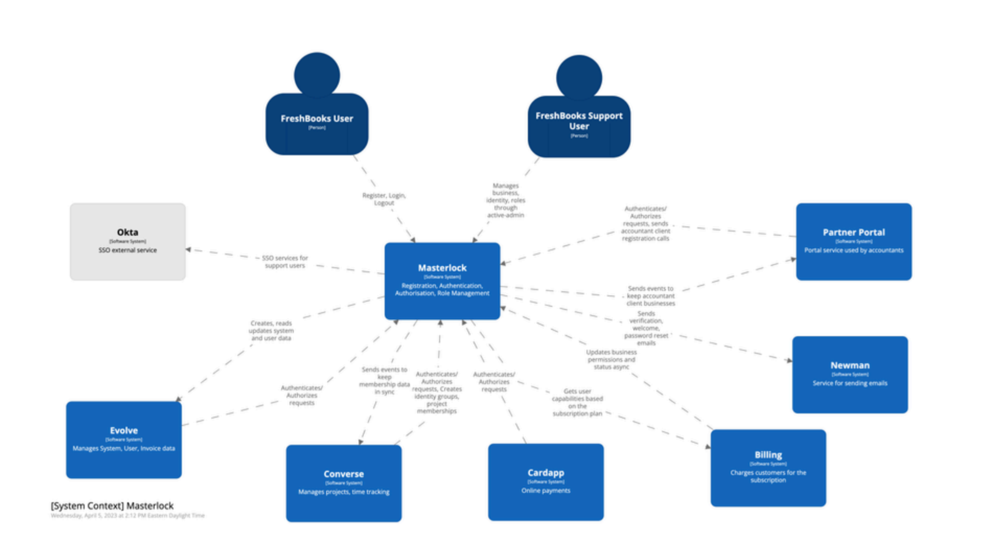
AuthN/AuthZ @ FreshBooks
]
Notes:
Before we start getting deeper, I wanted to quickly paint you a picture of how Authorization worked at FBs. Now, I know the C4 Diagram is slightly blurry here, but that’s ok. We’re not after the details here. The main thing to note is that all systems are pointing to the system in the middle called MasterLock MasterLock is FB’s Core AuthN + AuthZ System.

Slide 38
AuthN/AuthZ @ FreshBooks
]
6
5
4
1 2 3
Notes:
But that’s ok. What I want to highlight was the 6 systems where the 933 code changes happened.
And also the fact that, all 6 systems were talking to the central system there in the middle called MasterLock The main thing to note is that all systems are pointing to the system in the middle called MasterLock MasterLock is FB’s Core AuthN + AuthZ System.

Slide 39
AuthN/AuthZ@ FreshBooks
]
Everything depends on Masterlock
Notes:
So you can imagine, everything depended on Masterlock
Let’s look at an example of the 1 of the 933 places I had to check

Slide 40
Tech Stack @ FreshBooks
]
Express.js, React - UI
Python - Backend
MasterLock (AuthN + AuthZ) - Ruby on Rails
Notes:
Since we’re voyeurs when it comes to other people’s Tech Stack, let me indulge you a little with what FreshBooks was like

Slide 41
Masterlock - Center of it all
]
Masterlock - Devise (AuthN), Pundit (AuthZ)
50ms is expected norm for AuthZ calls
Notes:
DataDog Joke : I originally used the word Budget instead of Threshold and I evoked PTSD for people who got stung by their bill increase couple of years ago.

Slide 42
Masterlock - Center of it all
]
Masterlock - Devise (AuthN), Pundit (AuthZ)
50ms is expected norm for AuthZ calls
Masterlock’s calls were getting slower
DataDog Threshold increased from 250ms -> 600ms
-> AuthZ Calls were taking up to 600ms
Notes:
DataDog Joke : I originally used the word Budget instead of Threshold and I evoked PTSD for people who got stung by their bill increase couple of years ago.

Slide 43
Masterlock - Center of it all
]
Masterlock - Devise (AuthN), Pundit (AuthZ)
50ms is expected norm for AuthZ calls
Masterlock’s calls were getting slower
DataDog Threshold increased from 250ms -> 600ms
-> AuthZ Calls were taking up to 600ms
Increased AuthZ calls impacting UX negatively
Decentralised Mess -> Role Data with MasterLock (Pundit), Role Logic stored with each Application
Notes:
So you had Data that was stored centrally, but logic was distributed, which isn’t necessarily bad, but in my case it was

Slide 44
Typical Code for Checking Permissions
Typical API Endpoint Call:- def put(self, business_uuid):
if not self.permission.can_update():
raise ForbiddenError
# ... do some updates ...
Typical Authorization Check:-
class <BusinessUnit>Permission(BasePermission):
def can_read(self):
return self.role in [
self.BUSINESS_OWNER_ROLE,
self.BUSINESS_PARTNER_ROLE,
self.ACCOUNTANT_PARTNER_ROLE,
]
def can_update(self):
return self.role in [
self.BUSINESS_OWNER_ROLE,
self.BUSINESS_PARTNER_ROLE,
self.ACCOUNTANT_PARTNER_ROLE,
]
Notes:
So let’s look at an example of the 1 of the 933 places I had to check. This is a Rest API Call checking for Permissions. You can see the Permissions seem to be embedding with the code or the business object here

Slide 45
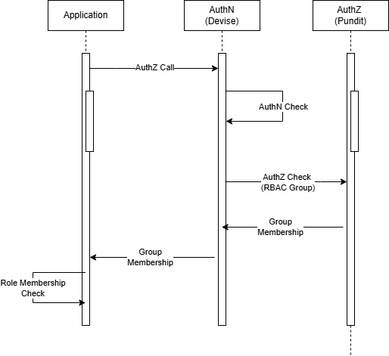
An AuthZ Call @ FreshBooks
Notes:
Key things to note is that we have 3 places and multipel calls doing the whole AuthN + AuthZ sequence. This sequence is taking up to 600ms

Slide 46
Role Based Access Control (RBAC)
Typical API Endpoint Call:- def put(self, business_uuid):
if not self.permission.can_update():
raise ForbiddenError
# ... do some updates ...
Typical Authorization Check:-
class <BusinessUnit>Permission(BasePermission):
def can_read(self):
return self.role in [
self.BUSINESS_OWNER_ROLE,
self.BUSINESS_PARTNER_ROLE,
self.ACCOUNTANT_PARTNER_ROLE,
]
def can_update(self):
return self.role in [
self.BUSINESS_OWNER_ROLE,
self.BUSINESS_PARTNER_ROLE,
self.ACCOUNTANT_PARTNER_ROLE,
]
Role Based Security
Role based Access Control
(RBAC)
Notes:
Everyone has seen this type of code before right? Imagine changing / analysing 933 instances of code like this throughout your entire SAAS application

Slide 47
Pros & Cons with RBAC (Role based)
Pros
Ubiquitous
Easy to implement
Great for small/medium apps
Well defined Permission Set that doesn’t change

Slide 48
Pros & Cons with RBAC (Role based)
Pros
Ubiquitous
Easy to implement
Great for small/medium apps
Well defined Permission Set that doesn’t change
Cons
Not Scalable for Enterprise / SAAS
Role Explosion - Inventing Roles for new permission scenarios
Simple, Low Granular Permissions
Tight Coupling
- Permission Logic & Code Logic

Slide 49
Are there Alternatives out there?
Notes:
Just filled my Cat meme Quota. Check.

Slide 50
Attribute Based Access Control (ABAC)
In a Nutshell : -
Method of doing Access Control using attributes across 4 areas plus policies
Subject (User)
Resource
Action
Environment
Notes:
So during my research, I can across something called ABAC.

Slide 51
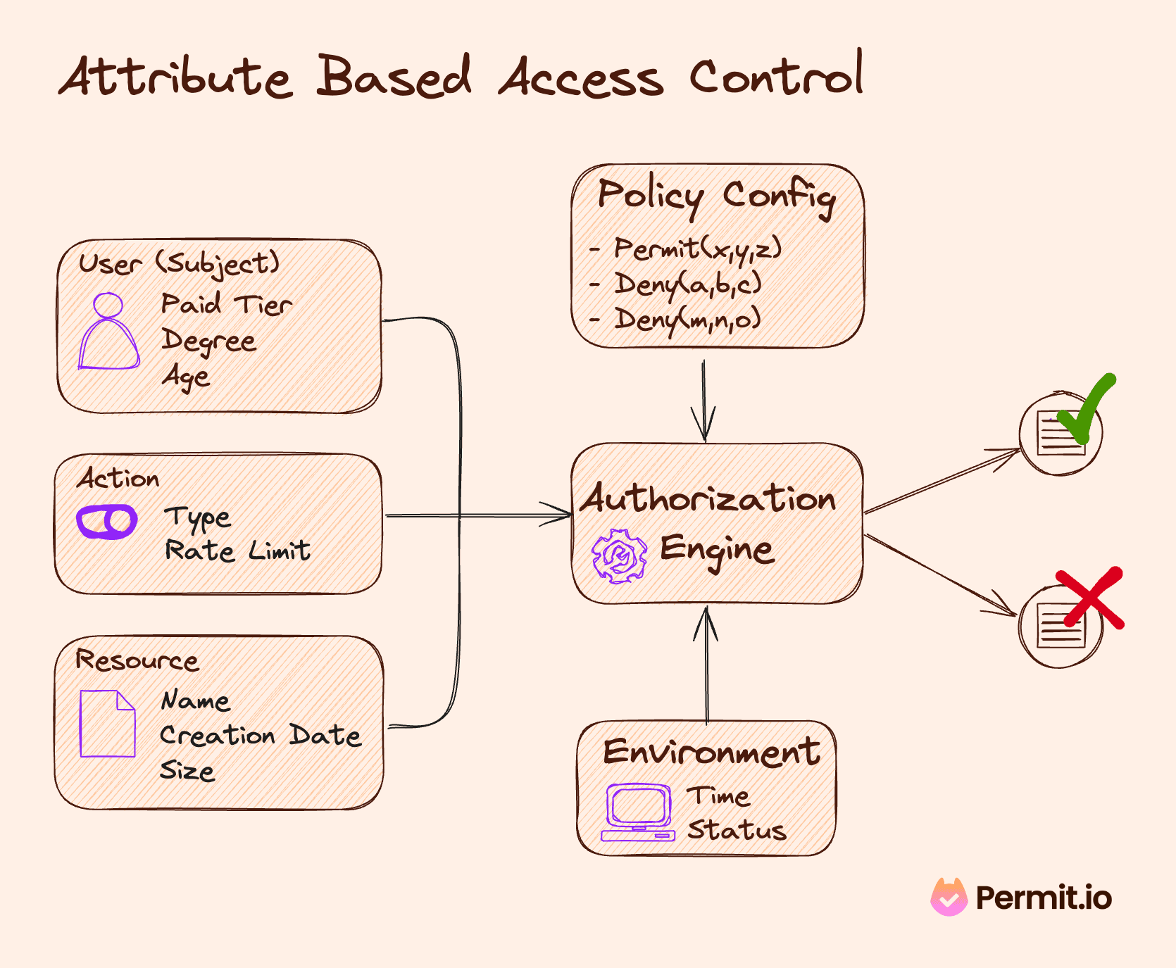

Slide 52

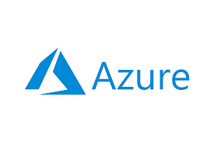

Notes:
Cloud Providers provide ABAC to protect your cloud resources and infrastructure online

Slide 53
Attribute Based Access Control (ABAC)
Pros
Granular / Flexible Permissions
Scalable - If done right
Better Security + Compliance
Centralised
Cloud Providers

Slide 54
Attribute Based Access Control (ABAC)
Pros
Granular / Flexible Permissions
Scalable - If done right
Better Security + Compliance
Centralised
Cloud Providers
Cons
Complex!
Performance - Latency
Harder to Audit
XACML - Extensible Access Control Markup Language
Cloud Providers -
Cloud Resources only
Notes:
XACML seems to be standard way of doing ABAC

Slide 55
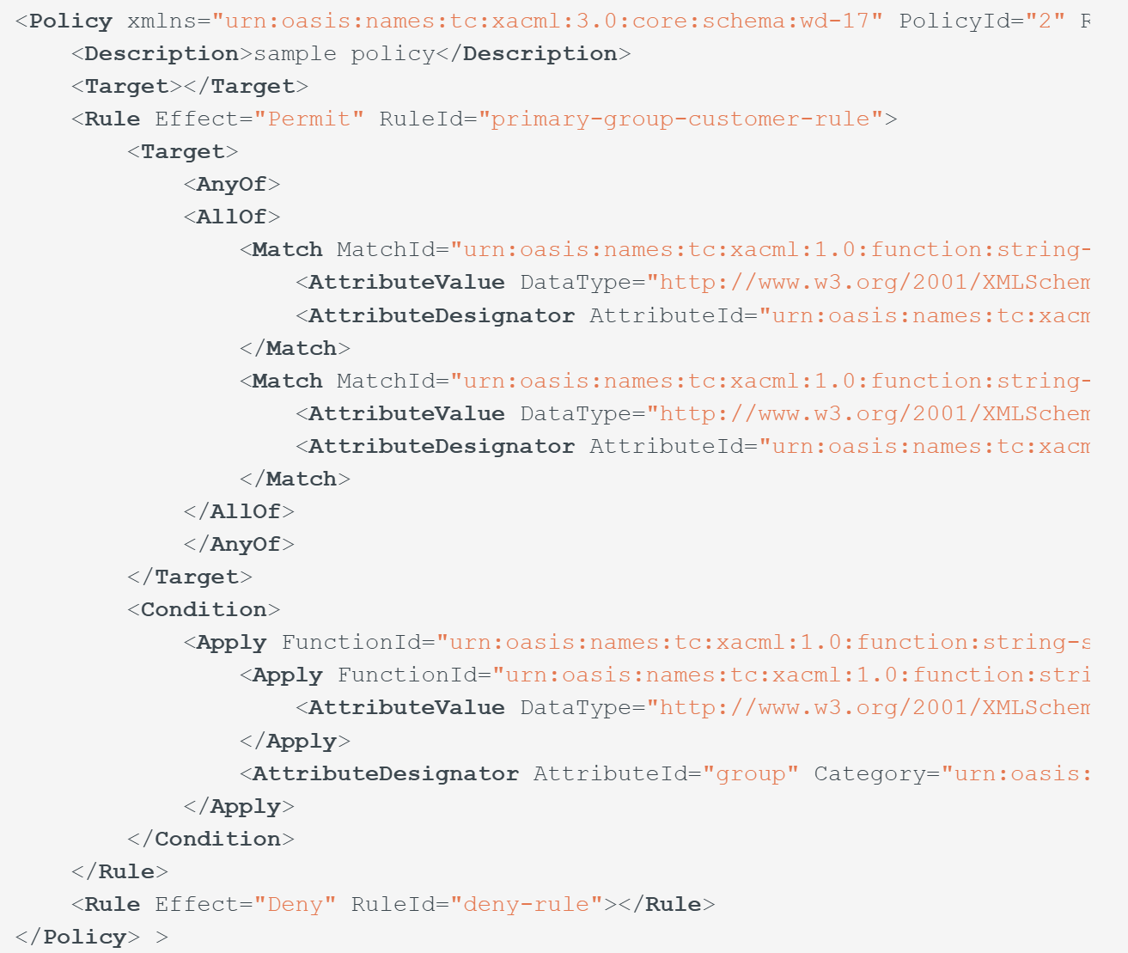
ABAC - XACML Example
Notes:
Any XML devotees out there?

Slide 56
XML Anecdote
"XML is like violence:
If it doesn't solve your problem, you aren't using enough of it."
- Chris Maden
Notes:
He’s a Mad one, that Chris fellow. Be nice to Chris

Slide 58
Google Zanzibar
Notes:
Then I came across something called Google Zanzibar. ….. And you might be thinking …

Slide 59
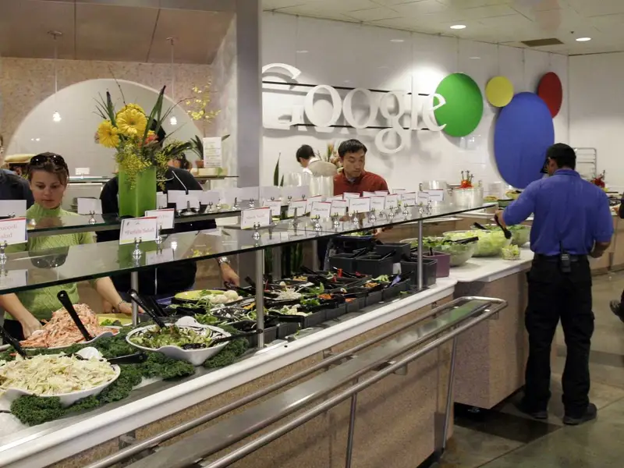
Google Zanzibar
Notes:
… is it their famous Salad bar in their staff restaurants? No it isn;t …. But have a look at this impressive salad bar anyways. Enough to make me go full Vegan for one meal per week,

Slide 60
Google Zanzibar
Google’s AuthN + AuthZ system for all of Google’s Services
Internal + External
Calendar, Cloud, Drive, Maps, Photos, and YouTube etc
First announced as a White Paper in 2019
Notes:
It’s basically Google’s MasterLock if you like. I’m pretty sure it’s not written in Ruby.

Slide 61
Google Zanzibar - Stats
95th-percentile latency of less than 10 milliseconds
Availability of 99.999% over 3 years (Five 9s)
2 trillion relational tuples that occupy close to 100 terabytes
> 10 million client queries per second (QPS)
10,000 servers organized in several dozen clusters
Planetscale Numbers!
Notes:
50ms is considered a good time for an Authorisation call. In FBs, we had to increase our DataDog latency budget from 250ms to 600ms. Now you need to be wary, when you see the word PlanetScale bandied about

Slide 62

Notes:
Now, you Should be very wary when someone mentions PlanetScale, because this is what it usually means. Your needs are here, Big Tech needs are way over there.

Slide 63
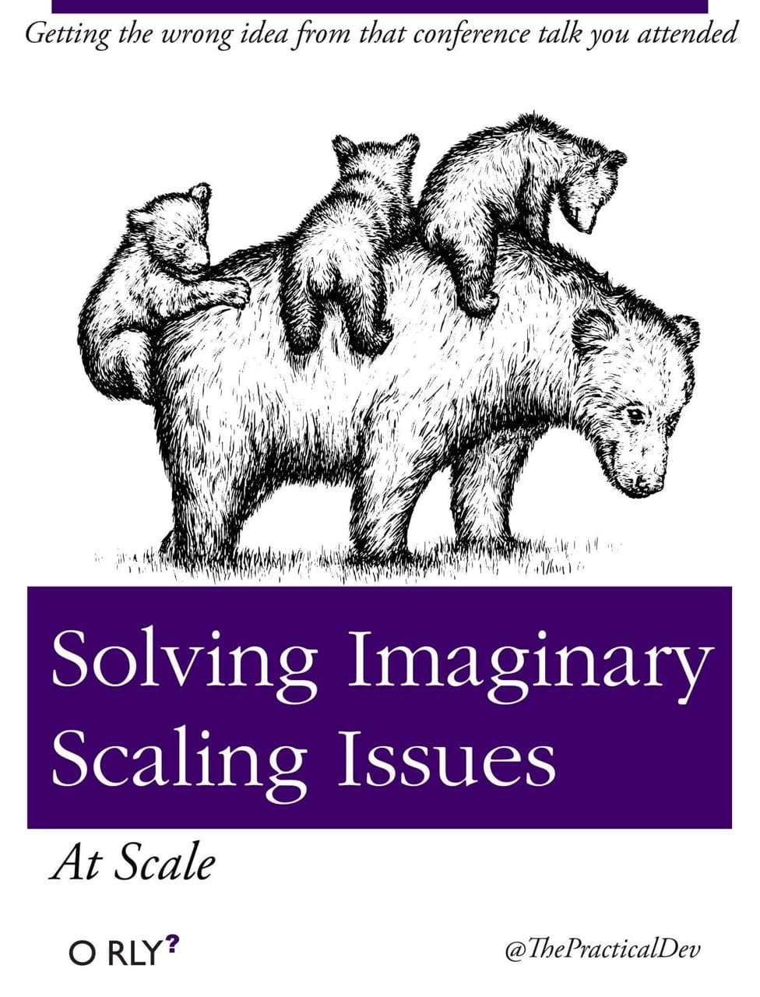
Lest we forget -
Kubernetes
Microservices
Notes:
We’ve all read this Classic O’Reilly Book? Raise of hands? Who’s been burnt by Kubernetes and Microservices?

Slide 64

Google Zanzibar
2 Trillion Relation Tuples
Relationship based Access Control (ReBAC)
Notes:
In my earlier slide, I mentioned 2 trillion relation tuples, so that was a hint of what Zanzibar uses underneath

Slide 65

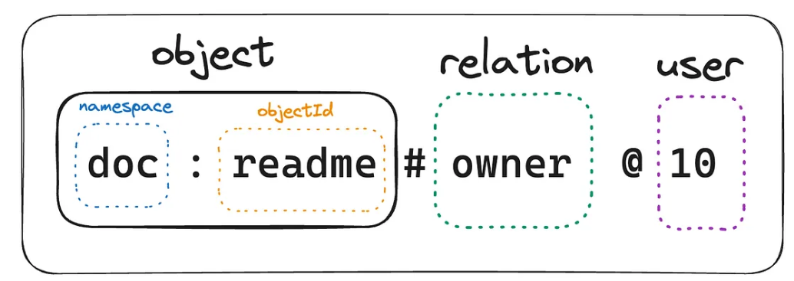
Google Zanzibar - Relational Tuples
Notes:
Relation Tuples are just sequence of values that denotes a relation between an object and a user

Slide 66
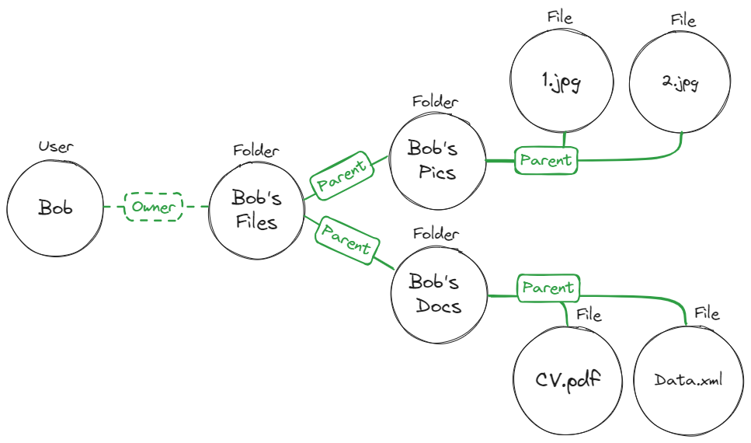

Relationship Based Access Control (ReBAC)
Notes:
So you can imagine using Tuples to build out a hierarchical access control model like a Tree or a Graph. This example here shows Bob’s Google Drive permissions for example, where it denotes relationship between Bob and his files, which is further broken down into Folders and Files

Slide 67
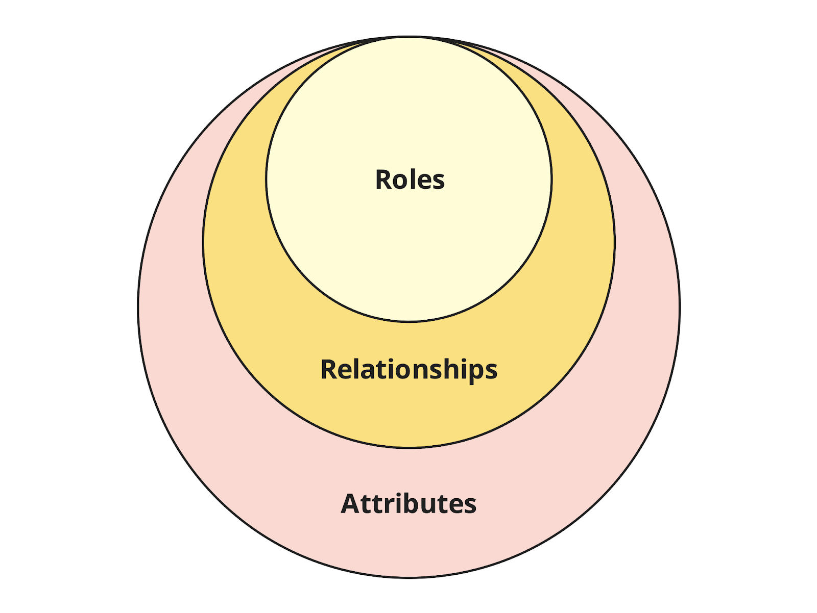

RBAC vs ABAC vs ReBAC - Concepts
Notes:
We can take a step back and look at it from a conceptual viewpoint. So Attributes > Relationships > Roles. If you’re thinking about moving from RBAC to ReBAC, the above graph tells you that a natural migration path exists

Slide 68
Relationship based Access Control (ReBAC)
Pros
Granular / Flexible Permissions
Scalable
Visual | Graphical
Centralised
Notes:
ReBAC is going to be similar to ABAC

Slide 69
Relationship based Access Control (ReBAC)
Pros
Granular / Flexible Permissions
Scalable
Visual | Graphical
Centralised
Cons
Relations can be complex to map
Learning curve - Graph Theory
Not as granular as ABAC - ?
Auditing - Could be challenging
Major Cloud Providers not offering
Notes:
Remember, Zanzibar was a Whiter Paper that was released, not a product.

Slide 70
Google Zanzibar Solutions
Open Source
SpiceDB
OpenFGA
Ory / Keto
Permify
Permit.io
Topaz
Commercial
Oso
Auth0 / Okta (OpenFGA)
Notes:
Google Zanzibar is not open source, but they did release a white paper on it. So plenty of people rushed off to build their interpretations of it when the white paper was published

Slide 71
Google Zanzibar Solutions
Open Source
SpiceDB
OpenFGA
Ory / Keto
Permify
Permit.io
Topaz
Commercial
Oso
Auth0 / Okta (OpenFGA)
Notes:
I’ll be doing a quick demo showcasing ReBAC concepts in Topaz, and the reason I’ve picked Topaz is for several reasons.

Slide 72

Topaz
Open Source by Aserto
Supports Open Policy Agent (OPA) and Zanzibar
OPA -> Terraform for Policies
Topaz’s Policies -> Json like DSL
Supports RBAC, ABAC and ReBAC
Notes:
Open Policy Agent is an Cloud Native Computing Foundation Project that provides a way of declaratively (DEE-CLARE-RATIVELY) writing policies as code (think Terraform for Policies)

Slide 73
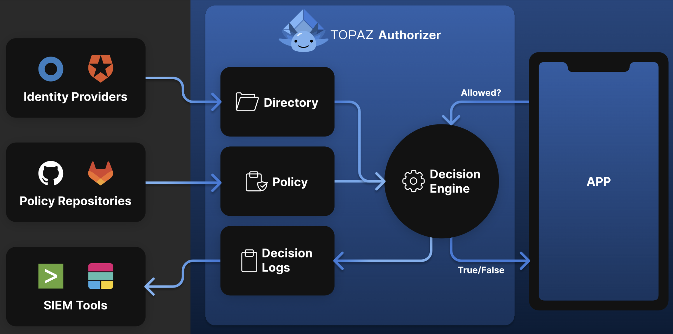
Topaz Architecture
Notes:
It’s similar to the ABAC diagram I showed earlier, but much simpler.
ID Providers does the Auth part (and you can connect external ones) Policy Repos are your data stores of your policies SIEM - Security Information and Event Managment - Real-time visibility across an organization's information security systems

Slide 74
Topaz - RBAC Policy Example
allowed {
ds.check({
"object_type": "tenant",
"object_id": input.resource.tenant_id,
"relation": "viewer",
"subject_type": "user",
"subject_id": input.user.id,
})
}
Notes:
It’s using json like DSL, not violent XML as you can see.
And this policy is an example authorization check to see if the Subject is able to view Tenant’s detail by checking to see if it’s in the viewer group

Slide 75
Topaz - ReBAC Policy Example
allowed {
ds.check({
"object_type": "document",
"object_id": input.resource.doc_id,
"relation": "can_read",
"subject_type": "user",
"subject_id": input.user.id,
})
}
Notes:
This policy example is an Authorization check is to see if the user has a “can_read” relationship with this particular document defined

Slide 76
Topaz - RBAC & ReBAC
allowed {
ds.check({
"object_type": "tenant",
"object_id": input.resource.tenant_id,
"relation": "viewer",
"subject_type": "user",
"subject_id": input.user.id,
})
}
allowed {
ds.check({
"object_type": "document",
"object_id": input.resource.doc_id,
"relation": "can_read",
"subject_type": "user",
"subject_id": input.user.id,
})
}
Notes:
This check is to see if the user has a “can_read” relationship defined against this particular document

Slide 77
Topaz - ABAC Policy Example
allowed {
ns := time.now_ns()
day := time.weekday(ns)
day == data.workdays[_]
input.user.properties.department == "Sales"
}
Notes:
This example policy is checking to see if the user works in Sales and accessing this resource during working hours during the working week

Slide 78
Topaz - ASP.NET Core Example
//Startup.cs
using Aserto.AspNetCore.Middleware.Extensions;
using Aserto.AspNetCore.Middleware.Policies;
// ...
//Aserto options handling
services.AddAsertoAuthorization(options => Configuration.GetSection("Aserto").Bind(options));
//end Aserto options handling
services.AddAuthorization(options =>
{
options.AddPolicy("Aserto", policy => policy.Requirements.Add(new AsertoDecisionRequirement()));
});
// ...
app.UseAuthorization();
//<Some>Controller.cs
[ApiController]
[Route("/todos")]
public class GetTodosController : ControllerBase
{
//...Some code
[HttpGet]
[Authorize("Aserto")]
public async Task<IEnumerable<TodoResource>> GetAllAsync()
{
var todos = await _todoService.ListAsync();
var resources = _mapper.Map<IEnumerable<Todo>, IEnumerable<TodoResource>>(todos);
return resources;
}
}
Notes:
So it’s pretty simple with ASP.NET - 4 lines of code to Startup.CS
And 1 Attribute per API Endpoint You’re just referencing Aserto’s libraries at the top. You’re asking to add their Authorization Capabiltiies to ASP.NET Core
And you’re asking it to use their Policies And at the endpoint, you’re asking it to use Aserto to to check for Authorization to call the endpoint and that’s it

Slide 79
RBAC, ReBAC and ABAC - Which Path?
Notes:
We can take a step back and look at it from a conceptual viewpoint. So Attributes > Relationships > Roles. If you’re thinking about moving from RBAC to ReBAC, the above graph tells you that a natural migration path exists

Slide 80
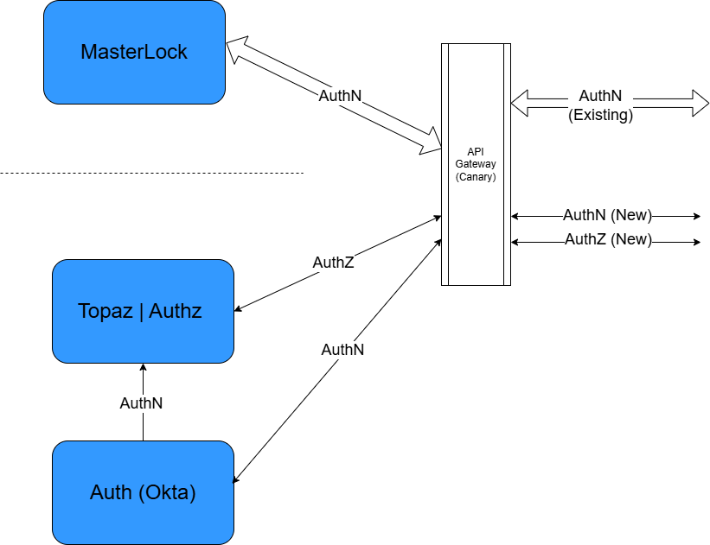
FreshBooks - A Vision Unfulfilled
Notes:
So, I want to go back to my FreshBooks example and in particular, to my vision of eventually Masterlock and improving its AuthZ speed

Slide 81
Access Control Models - Out of Scope
Policy Based Access Control (PBAC)
Access Control List (ACL)
Discretionary Access Control (DAC)
Etc etc
Notes:
So during my research, I can across something called ABAC.

Slide 82



Acknowledgements
Ben Robinson (aka The Intern) -
Ruby/TS/Python Fullstack Developer @ WrapBook
Chris Simon - DDD-AU
George Jayaratnam - Quant Risk Management, Data Engineering

Slide 83
Take Away
There are solutions out there. No need to jump out of buildings!
Notes:
No matter how mission impossible a situation might be, there are always solutions out there.

Slide 84
Q & A
If I didn’t answer your question,
please send me a message on LinkedIn
https://www.linkedin.com/in/francischung/

Slide 85
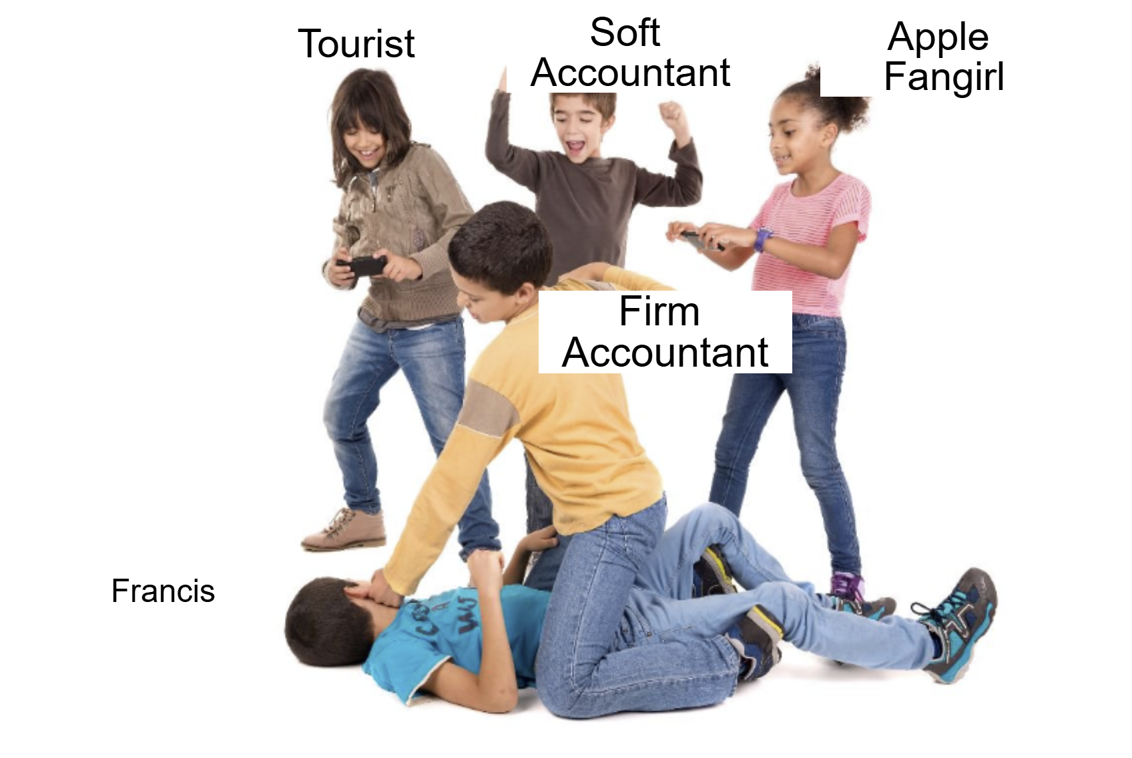
Accrual Beating
Notes:
Since we’re all peace loving pacifists here, I thought a picture of an Accrual Beating would be suffice. Security! Security!

Slide 86
References
https://www.permit.io/blog/what-is-abac
https://www.permit.io/blog/what-is-rebac
https://permify.co/post/relationship-based-access-control-rebac/
https://www.osohq.com/academy/relationship-based-access-control-rebac
https://www.descope.com/learn/post/rebac
https://zanzibar.tech/2Dy8fNih7E:m:1Y
https://authzed.com/blog/what-is-google-zanzibar
https://workos.com/blog/what-is-rebac-relationship-based-access-control
https://www.permit.io/blog/conditions-vs-relationships-choosing-between-abac-and-rebac
https://www.descope.com/blog/post/rbac-vs-rebac
https://www.aserto.com/blog/abac-vs-rebac-fine-grained-access-control
https://www.youtube.com/watch?v=oW4QRTke-Oc
https://www.youtube.com/watch?v=qn6c-XNLdqw
https://www.strongdm.com/blog/rbac-vs-abac
https://www.linkedin.com/in/francischung/

Slide 87
The End

Slide 88
RBAC (Role based) - Pros Revisited
Pros
Simple
Easy to implement
Great for small/medium apps
Well defined Permission Set that doesn’t change
Notes:
So I want to re-emphasise that if your use case lies within the blue points above, you should probably stick to RBAC. But it also doesn’t mean something like Zanzibar might not be for you either.

Slide 89
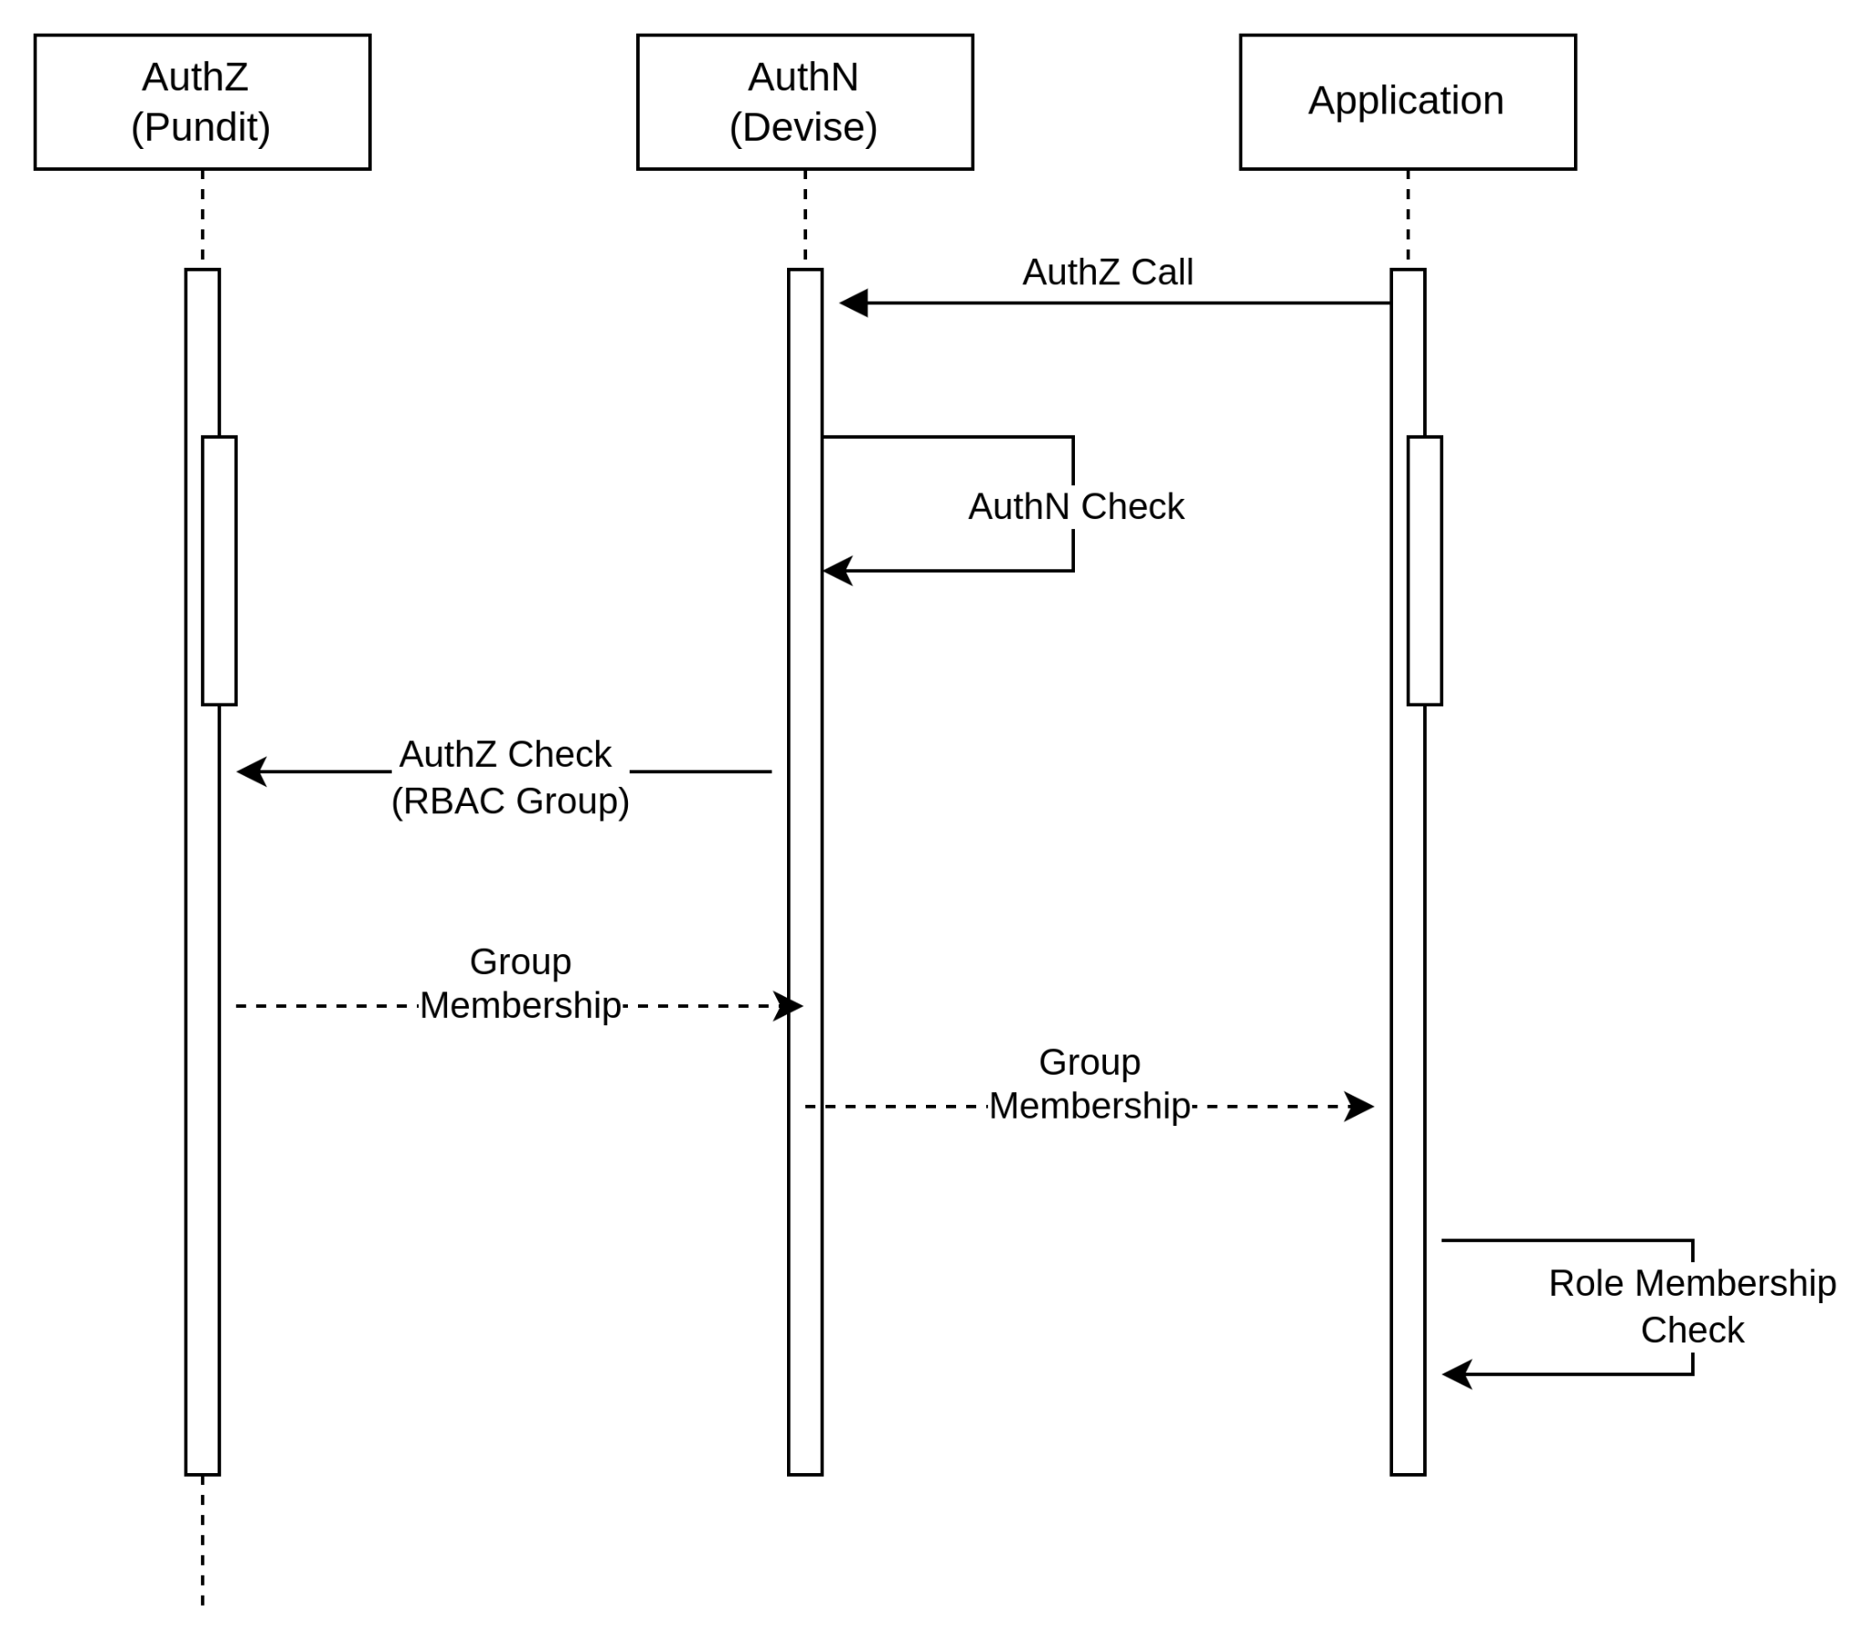
An AuthZ Call @ FreshBooks
Notes:
Key things to note is that we have 3 places and multipel calls doing the whole AuthN + AuthZ sequence. This sequence is taking up to 600ms

